Slide 1

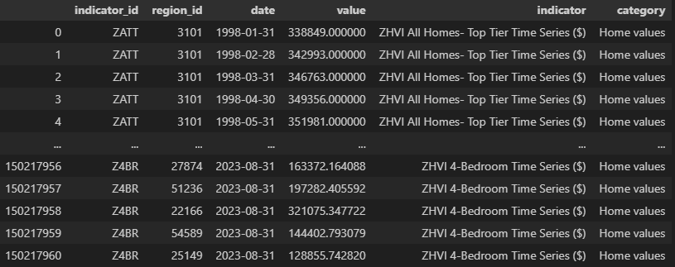
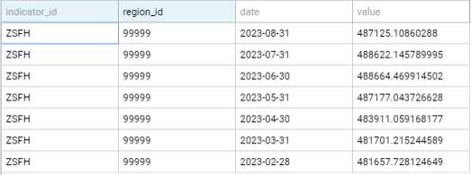
Nasdaq Real Estate Data Cleaning
Project 1 – Ashli ben, lovepreet singh, omar salloum, alexandru arnautu.

Slide 2
Our client is a real estate Tycoon, they have asked us to look up housing prices in the States over the past decade, so they can then use our data to invest in the housing market.

Slide 3
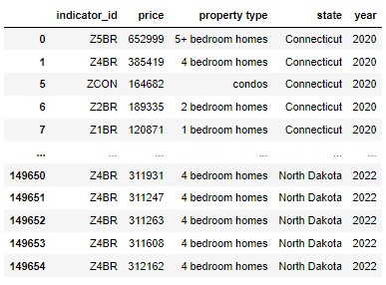
Original Data Frame
This Data Frame displayed the average monthly price of homes per property type and state

Slide 4
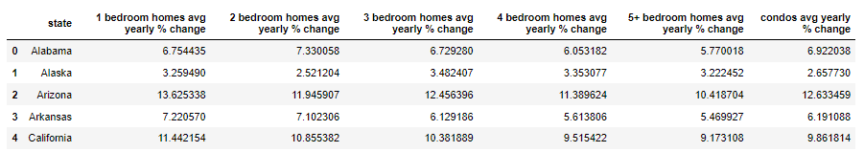
Annual Growth Rates Data Frame
Displayed the Average annual growth rate per State

Slide 5
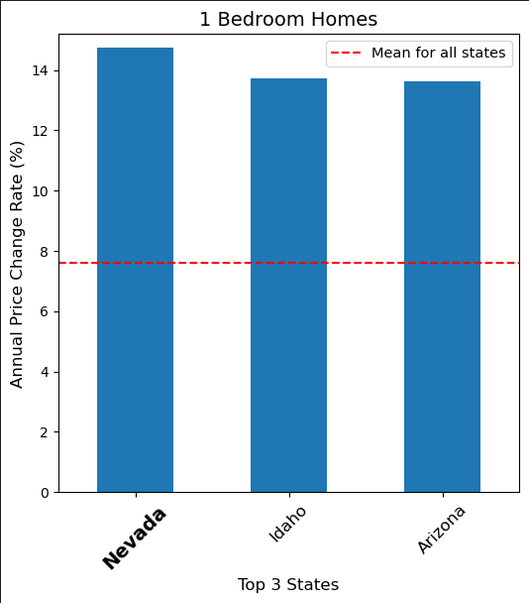
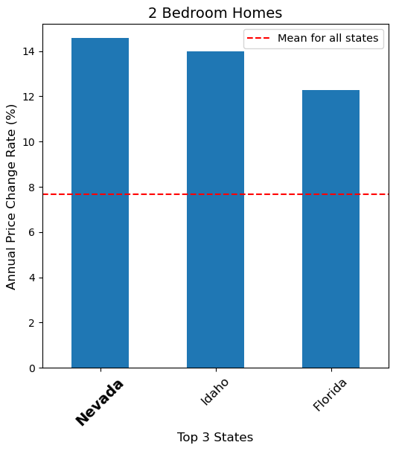
The top three states with the highest Annual Price Change Rate percentage for 1-bedroom and 2-bedroom homes in the past ten years are Nevada, Idaho, and Arizona. Nevada has the highest Annual Price Change Rate.

Slide 6
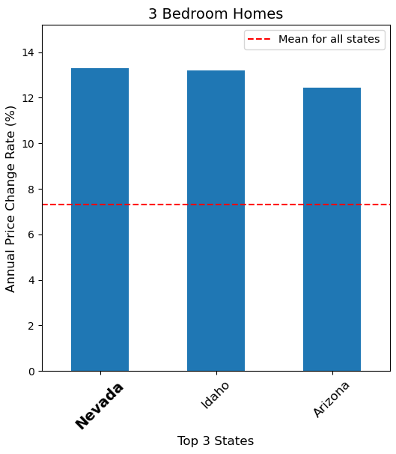
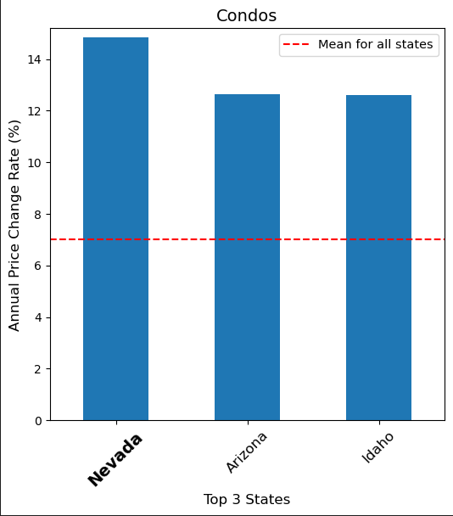
The top three states with the highest Annual Price Change Rate percentage for 3-bedroom homes and Condos in the past ten years are Nevada, Idaho, and Arizona. Nevada has the highest Annual Price Change Rate.

Slide 7
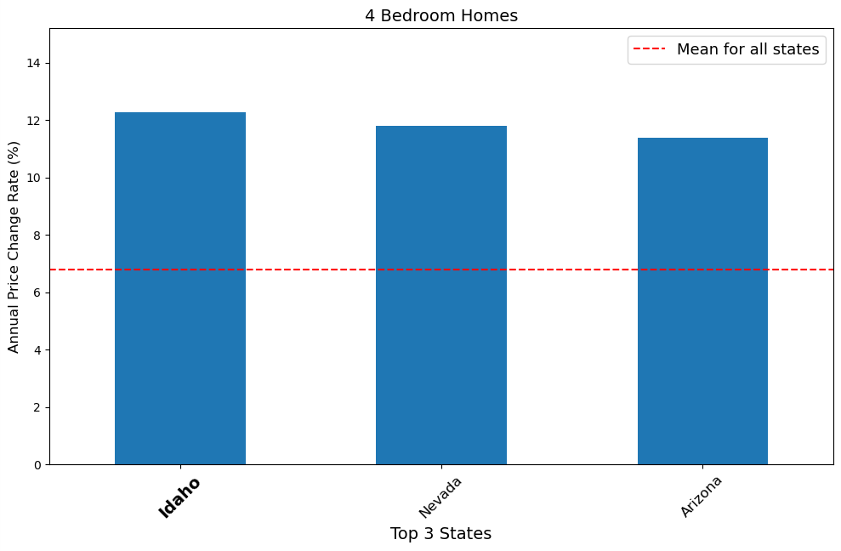
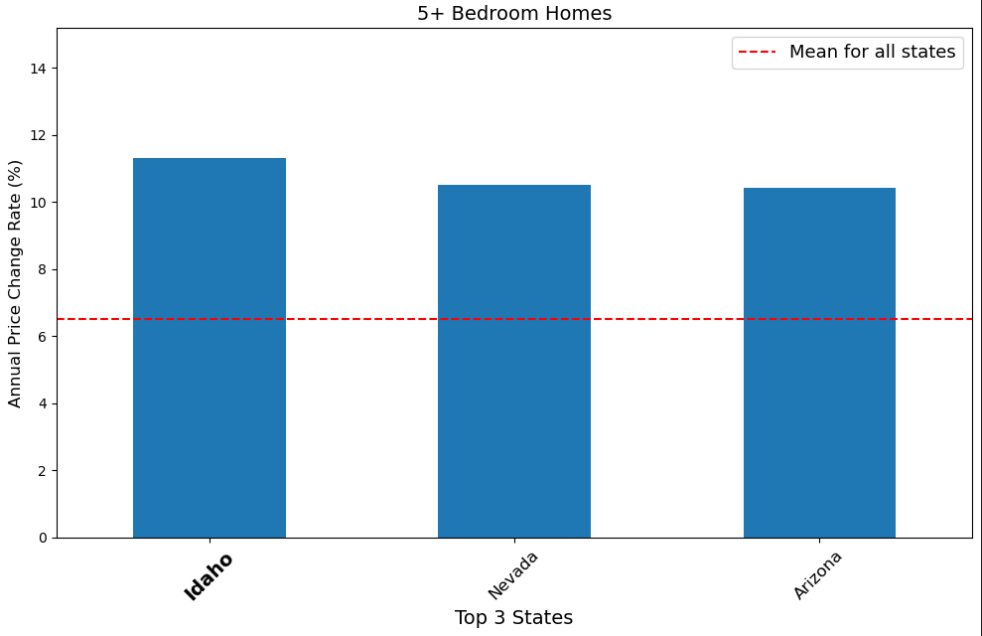
The top three states with the highest Annual Price Change Rate percentage for 4-bedroom homes and 5+-bedroom homes in the past ten years are Nevada, Idaho, and Arizona. Idaho has the highest Annual Price Change Rate.

Slide 8
After accumulating our data, we presented it to our client. Enthusiastically, they asked for linear regression plots on all the states with the highest Annual Price Change Rates…

Slide 9
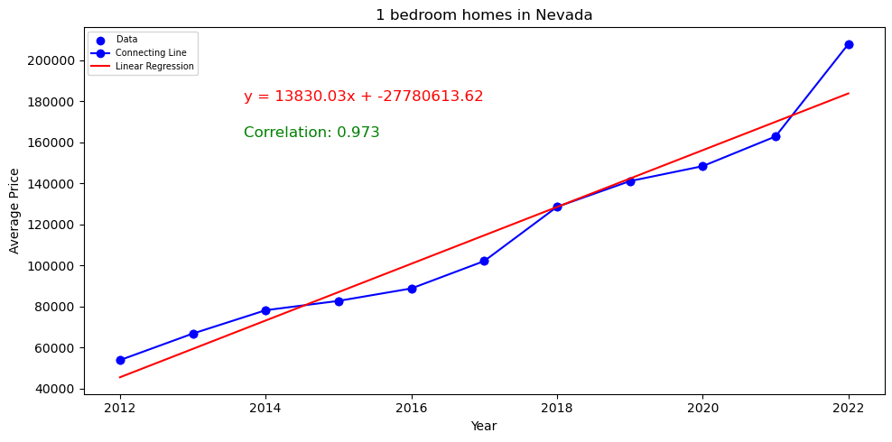
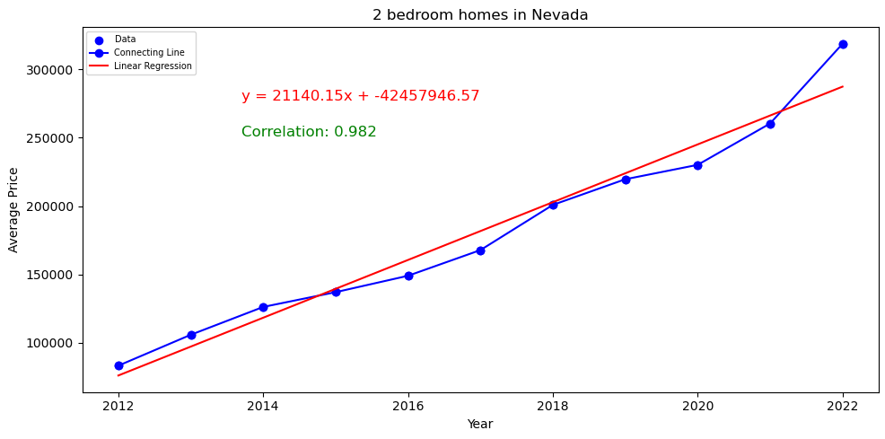
With an R-squared value of .9, our data is very reliable. As you can see the prices of 1 Bedroom and 2 Bedroom homes in Nevada have more than tripled in the past ten years.

Slide 10
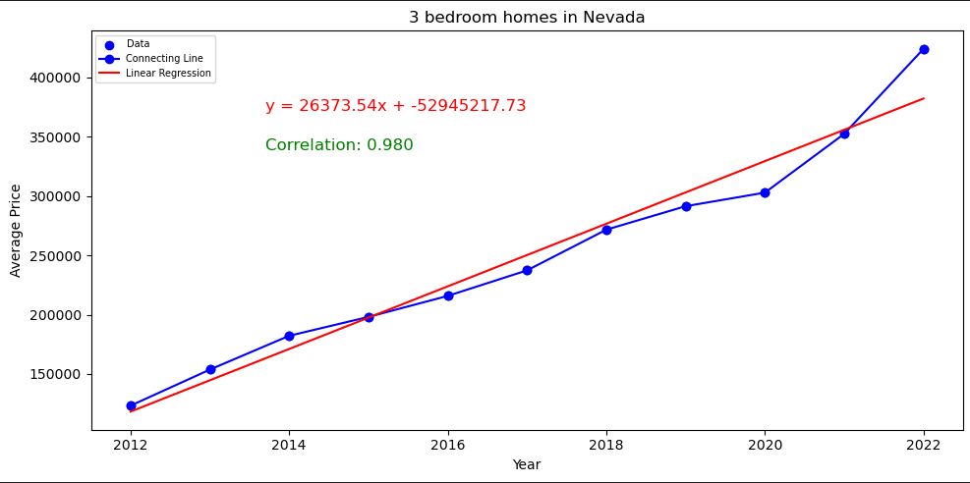
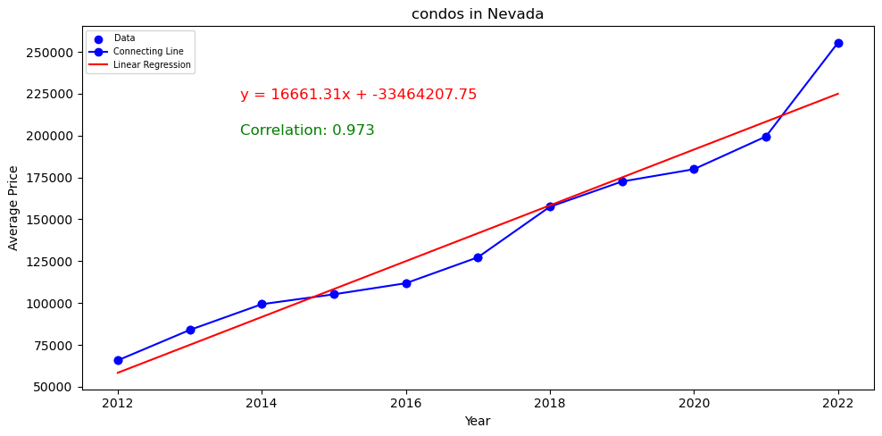
With an R-squared value of .9, our data is very reliable. As you can see the prices of 3 Bedroom homes and Condos in Nevada have more than quadrupled in the past ten years.

Slide 11
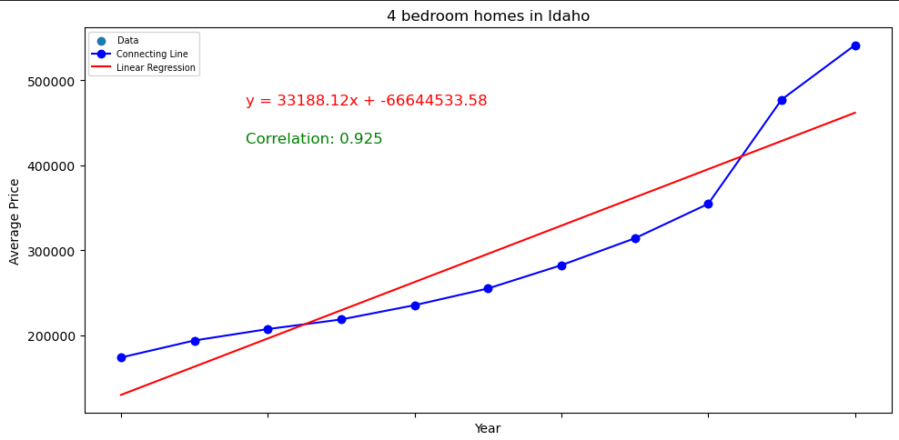
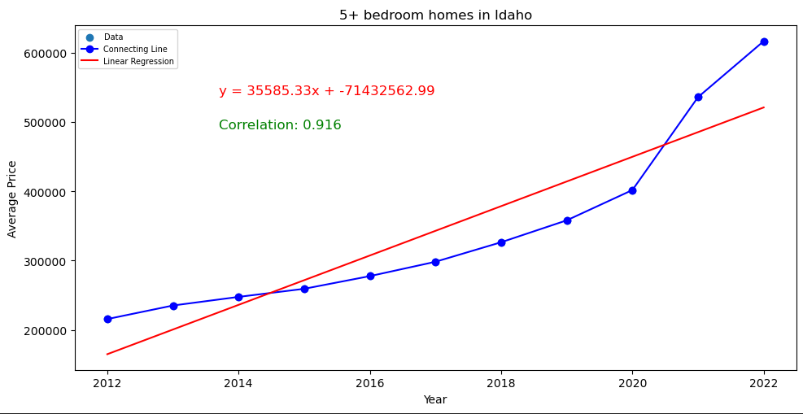
With an R-squared value of .9, our data is very reliable. As you can see the prices of 4 Bedroom homes and 5+ Bedroom homes in Idaho have also more than tripled in the past ten years.

Slide 12
Our Client was extremely satisfied with our data, they then explained how they were investing in a shipping company. We’ve been informed they would also like to invest in real estate connected to states which have a high impact in the shipping industry. We’ve deduced that Texas, California, Ohio and Illinois are the top 4 States in Freight Shipping.

Slide 13
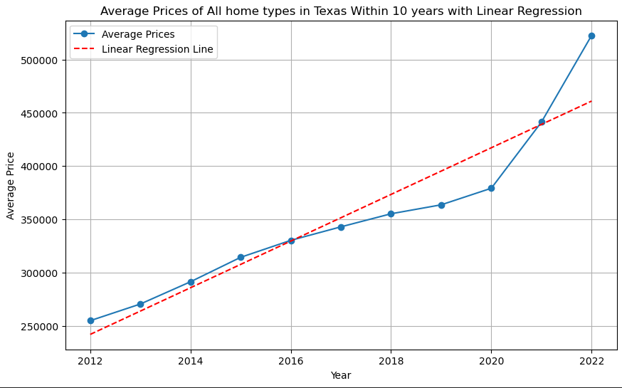
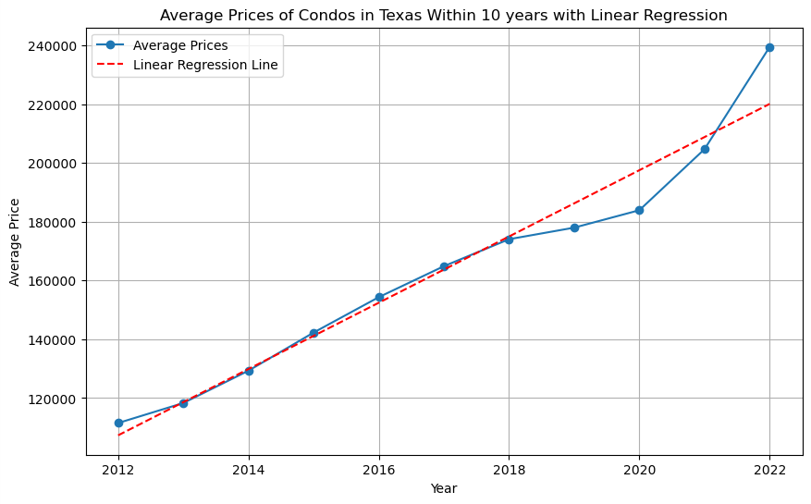
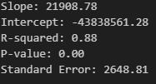

In the state of Texas, we can see that the price of Condos and the rest of the Home types have doubled in the past ten years. With an R-squared value of .8 and .9, our data is reliable.

Slide 14
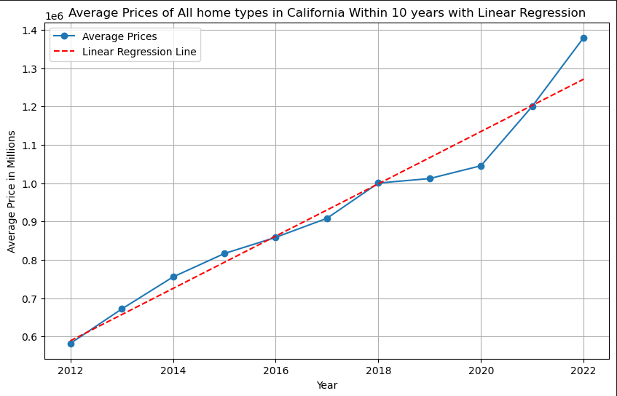
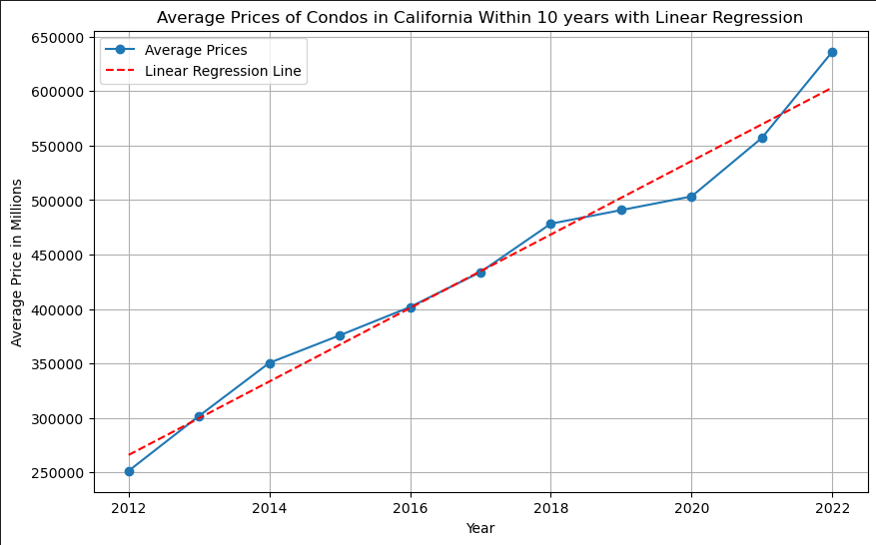








In the state of California, we can see that the price of all home types, and condos, have more than doubled in the past ten years. With an R-squared value of .9, our information is reliable.

Slide 15
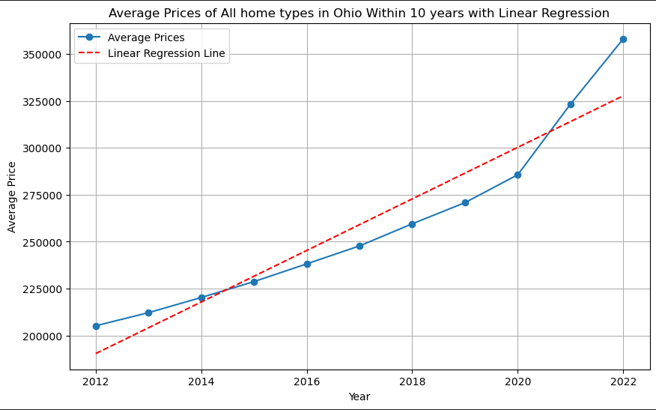
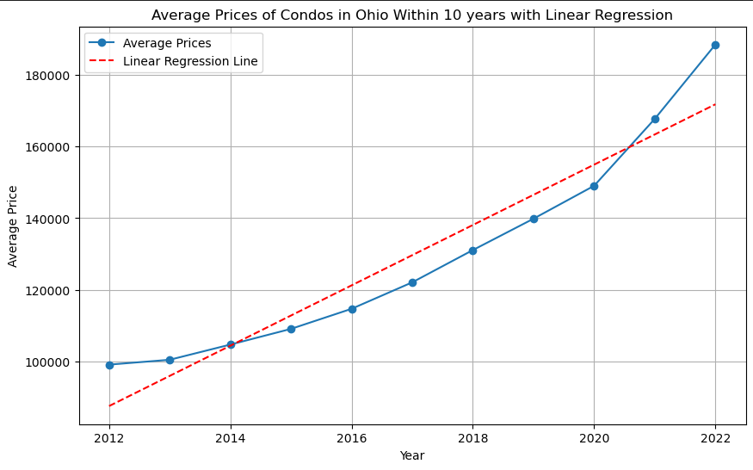


In the state of Ohio, we can clearly see that the prices of All home types and Condos have nearly doubled in the last ten years. With an R-squared value of .9, our data is reliable.

Slide 16
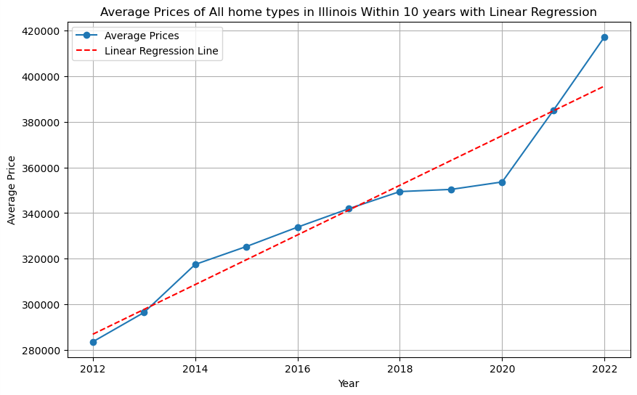
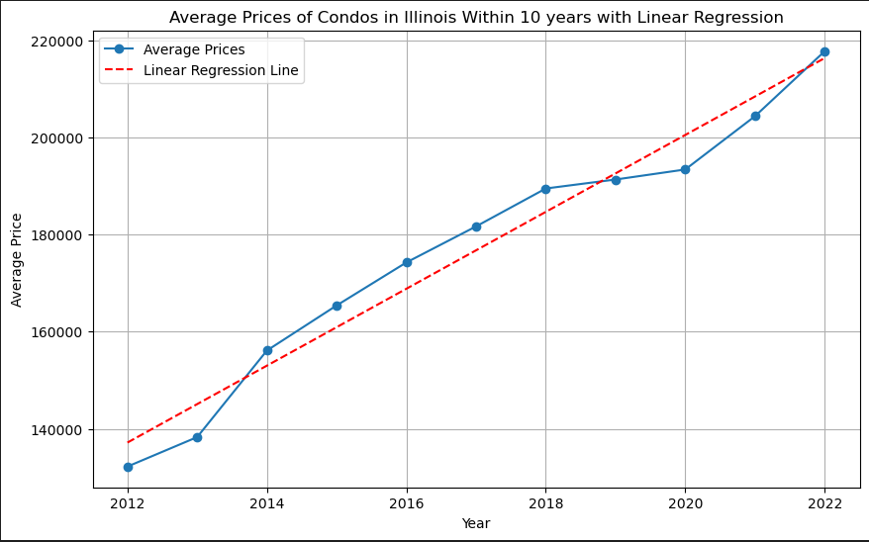


In the state of Illinois, we can clearly observe that the prices of All home types and Condos have nearly doubled in the past ten years. With an R-squared value of .9, we know our data is reliable.

Slide 17
After looking at all the data, we’ve come to the conclusion that the state of California has the highest Value, and greatest Linear Regression slope of property value increase in the last ten years, making it the ideal state to invest in Real Estate for our clients Freight Shipping interests.

Slide 18
Our client has never been happier, so much so that they have stated they would like to move their family to the States. They have asked us to explore the top two safest States and inform them which would be the better investment. We’ve deduced that Maine and New Hampshire are the top two safest States.

Slide 19
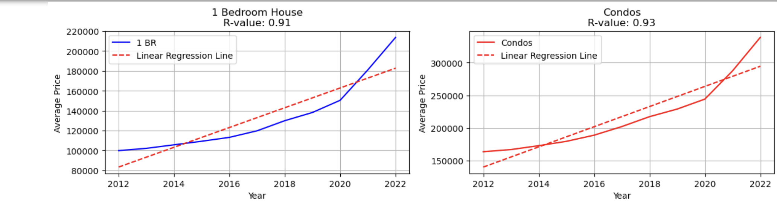
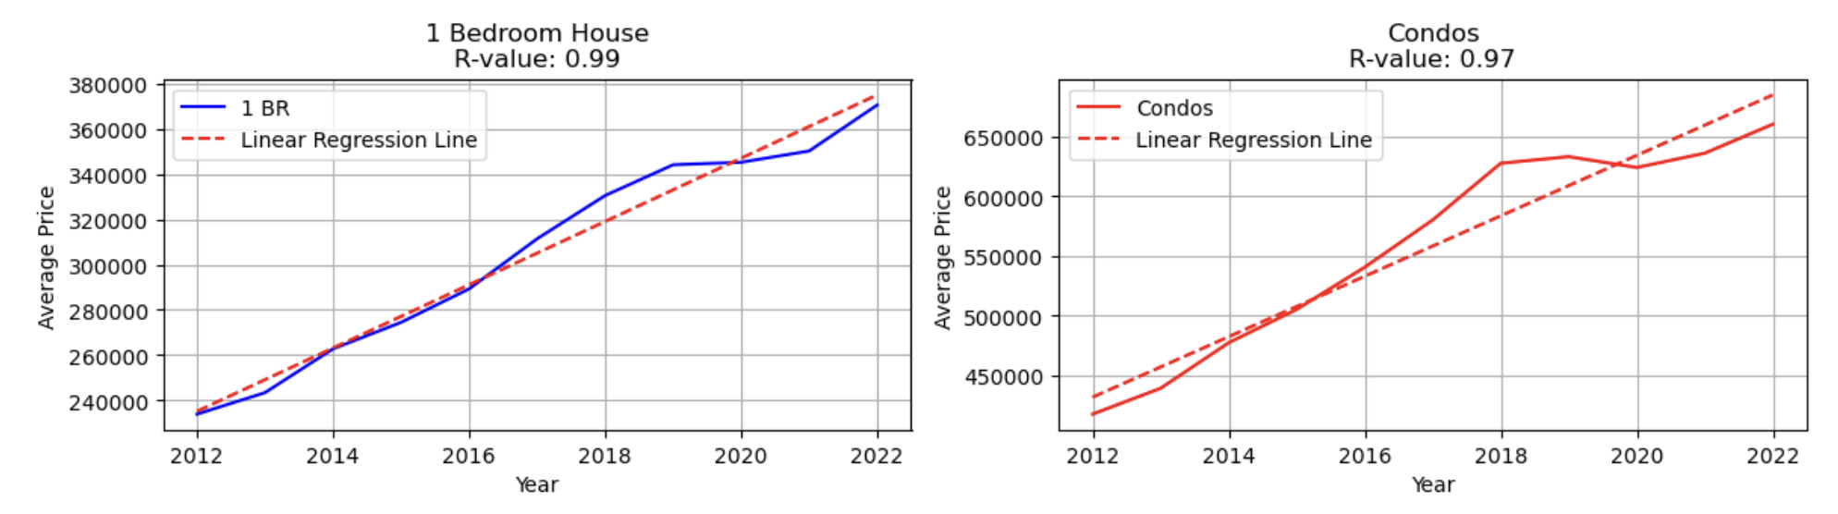
New Hampshire: 1 Bedroom and Condos (2012-2022)
Maine: 1 Bedroom and Condos (2012-2022)

Slide 20
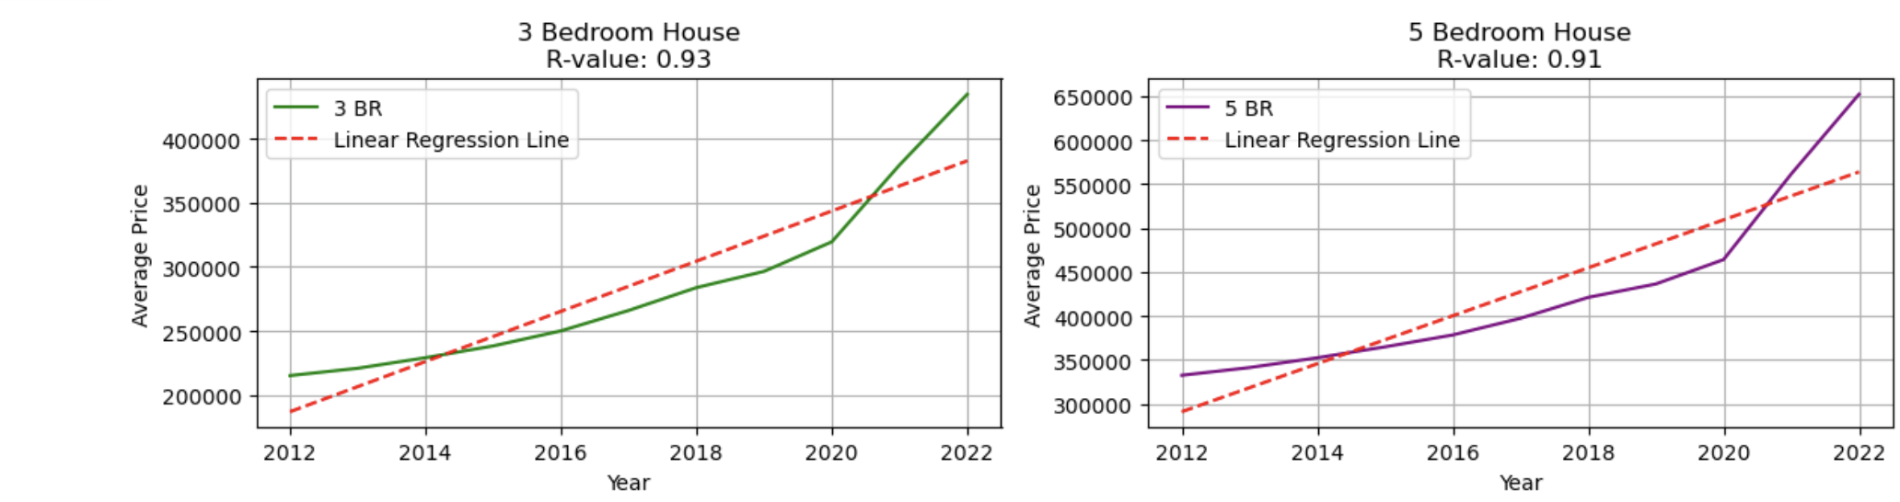
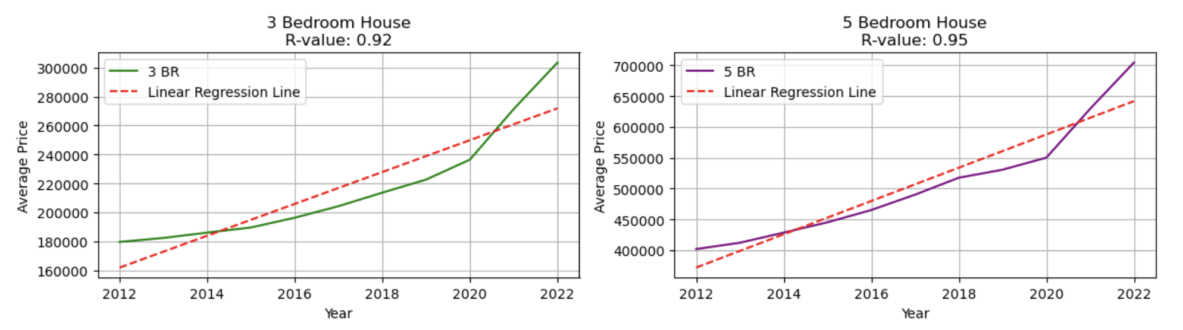
New Hampshire: 3 Bedroom and 5+ Bedroom (2012-2022)
Maine: 3 Bedroom and 5+ Bedroom (2012-2022)

Slide 21
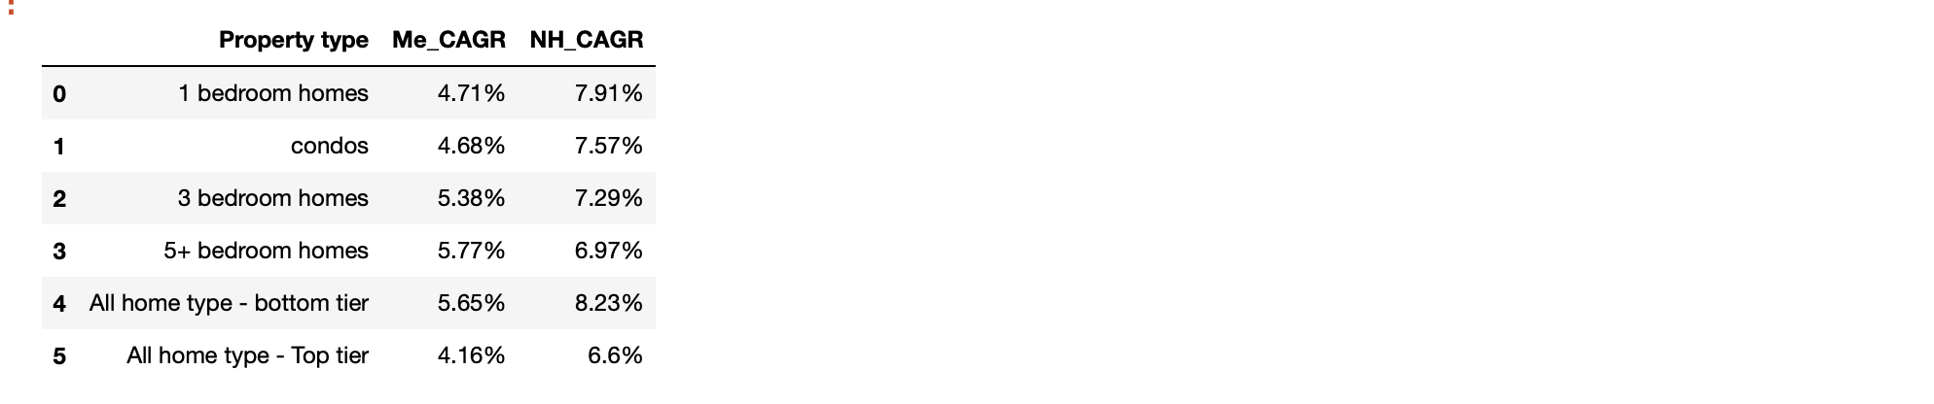
CAGR : Maine Vs New Hampshire (2012-2022)
New Hampshire indicates a higher Compound Annual Growth Rate when compared with Maine in all the property types in given years.

Slide 22
We have analyzed both the States(Maine and New Hampshire) and concluded that both states indicated a strong positive relationship between price and year. CAGR is higher for New Hampshire, therefore New Hampshire would be a wiser state to invest in.

